Slide 1
INTERNITY FOUNDATION
PRESENTATION ON RECURSION AND GREEDY ALGORITHM
Presented By:
Lipika Chugh
Aman Goyal

Slide 2
RECURSION
The process of defining an object in terms of smaller versions of itself is called recursion.
A recursive definition has two parts:
BASE:
An initial simple definition which cannot be expressed in terms of smaller versions of itself.
RECURSION:
The part of definition which can be expressed in terms of smaller versions of itself.

Slide 3
Recursion and Principle of Mathematical Induction
According to PMI, if a given F(n) is true for all natural numbers,
Base Case: Prove F(0) or F(1) is true
Induction Hypothesis: Assume F(k) is true
Induction Step: Using induction hypothesis, prove that F(k+1) is true

Slide 4
Example:
Prove that 1 + 2 + 3 + . . . + n= n(n + 1)/2
Base Case: L.H.S=F(0)=0 ; F(1)=1
R.H.S=n(n+1)/2=0 ; 1(1+1)/2=1
L.H.S=R.H.S
Base Case is true.
Induction Hypothesis: 1+2+3+...+K=K(K+1)/2
Assume this to be true

Slide 5
Induction Step: L.H.S: 1+2+3+...+(K+1)=(K+1)+[1+2+3+....+K]
=(K+1)+K(K+1)/2=(K+1)(K+2)/2
R.H.S: (K+1)(K+2)/2
L.H.S=R.H.S
Therefore, if F(K) is true then F(K+1) is true, similarly if F(n-1) is true then F(n) is true.
Hence, recursion works on the Principle of Mathematical Induction.

Slide 6
THE FACTORIAL OF A POSITIVE INTEGER: Example
For each positive integer n, the factorial of n denoted as n! is defined to be the product of all the integers from 1 to n:
n! = n.(n - 1).(n - 2) . . .3 . 2 . 1
Zero factorial is defined to be 1
0! = 1
EXAMPLE: | 0! = 1 | 1! = 1
 | 2! = 2.1 = 2 4! = 4.3.2.1 = 24 | 3! = 3.2.1 = 6 5! = 5.4.3.2.1 = 120
 | 6! = 6.5.4.3.2.1= 720 | 7! = 7.6.5.4.3.2.1= 5040
REMARK:
 | 5! = 5 .4.3 . 2 . 1 | = 5 .(4 . 3 . 2 .1) = 5 . 4!
In general, | n! = n(n-1)! for each positive integer n.

Slide 7
THE FACTORIAL OF A POSITIVE INTEGER: Example
oThus, the recursive definition of factorial function F(n) is:
1. F(0) = 1
2. F(n) = n F(n-1)

Slide 8
The Fibonacci numbers
o f(0) = 0, f(1) = 1
o f(n) = f(n – 1) + f(n - 2)
f(0) = 0
f(1) = 1
f(2) = f(1) + f(0) = 1 + 0 = 1
f(3) = f(2) + f(1) = 1 + 1 = 2
f(4) = f(3) + f(2) = 2 + 1 = 3
f(5) = f(4) + f(3) = 3 + 2 = 5
f(6) = f(5) + f(4) = 5 + 3 = 8

Slide 9
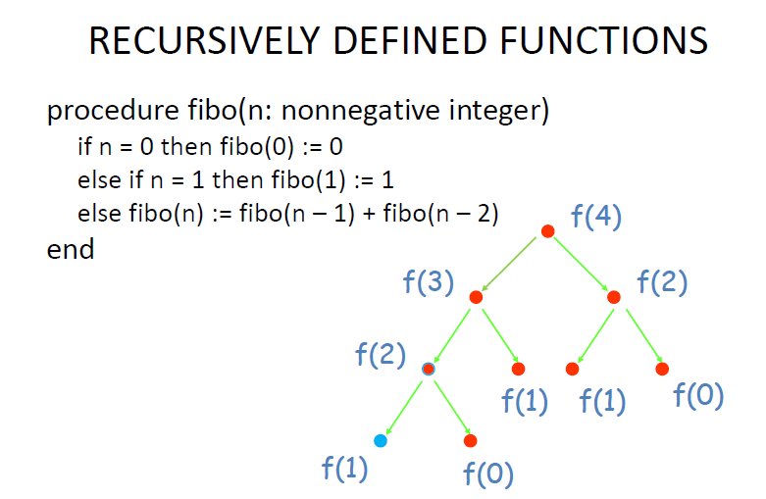

Slide 10
How recursion is handled
Every time a function is called, the function values, local variables, parameters and return addresses are pushed onto the stack.
Over and Over again
You might run out!

Slide 11
Types of Recursion
Single and Multiple Recursion
Recursion that only contains a single self- reference is known as single recursion. Eg: Factorial function
Recursion that contains multiple self-references is known as multiple recursion. Eg: Fibonacci function

Slide 12
What are the disadvantages of recursive programming over iterative programming?
Note that both recursive and iterative programs have the same problem-solving powers, i.e., every recursive program can be written iteratively and vice versa is also true. The recursive program has greater space requirements than iterative program as all functions will remain in the stack until the base case is reached. It also has greater time requirements because of function calls and returns overhead, which can be resolved with methods like memoization.
What are the advantages of recursive programming over iterative programming?
Recursion provides a clean and simple way to write code. Some problems are inherently recursive like tree traversals, Tower of Hanoi, etc. For such problems, it is preferred to write recursive code.

Slide 13
Tower of Hanoi
Tower of Hanoi is a mathematical puzzle where we have three rods and n disks. The objective of the puzzle is to move the entire stack to another rod, obeying the following simple rules:
1) Only one disk can be moved at a time.
2) Each move consists of taking the upper disk from one of the stacks and placing it on top of another stack i.e. a disk can only be moved if it is the uppermost disk on a stack.
3) No disk may be placed on top of a smaller disk.

Slide 14
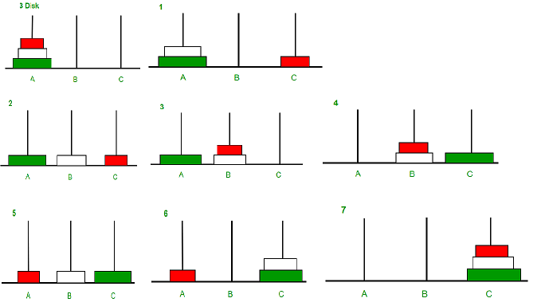
Approach :
Take an example for 2 disks :
Let rod 1 = 'A', rod 2 = 'B', rod 3 = 'C'.
Step 1 : Shift first disk from 'A' to 'B'.
Step 2 : Shift second disk from 'A' to 'C'.
Step 3 : Shift first disk from 'B' to 'C'.
The pattern here is :
Shift 'n-1' disks from 'A' to 'B'.
Shift last disk from 'A' to 'C'.
Shift 'n-1' disks from 'B' to 'C'.

Slide 15
Program:
void towerOfHanoi(int n, char from_rod,char to_rod, char aux_rod){
if (n == 1){
cout << "Move disk 1 from rod " << from_rod << " to rod " << to_rod<<endl;
return;
}
towerOfHanoi(n - 1, from_rod, aux_rod, to_rod);
cout << "Move disk " << n << " from rod " << from_rod <<" to rod " << to_rod << endl;
towerOfHanoi(n - 1, aux_rod, to_rod, from_rod);
}

Slide 16

‹#›

Slide 17
A SHORT LIST OF CATEGORIES
′ Algorithm types we will consider include:
Simple recursive algorithms
Backtracking algorithms
Divide and conquer algorithms
GREEDY ALGORITHM
Branch and bound algorithms
Brute force algorithms
Randomized algorithms
‹#›

Slide 18
OPTIMIZATION PROBLEMS
′ An optimization problem is one in which you want to find, not just a solution, but the best solution
′ A “greedy algorithm” sometimes works well for optimization problems
′ A greedy algorithm works in phases. At each phase:
You take the best you can get right now, without regard for future consequences
You hope that by choosing a local optimum at each step, you will end up at a global optimum
‹#›

Slide 19
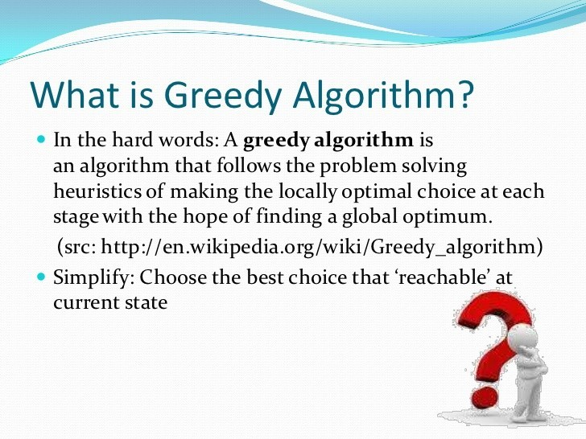
7
7

Slide 20
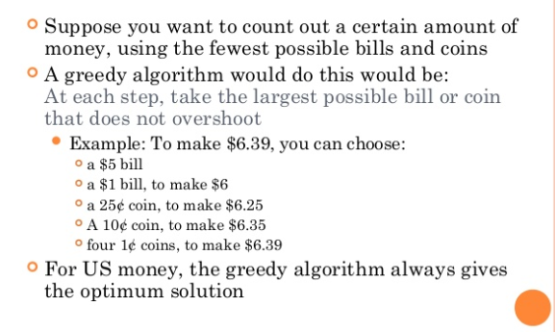
EXAMPLE: COUNTING MONEY
′
8

Slide 21
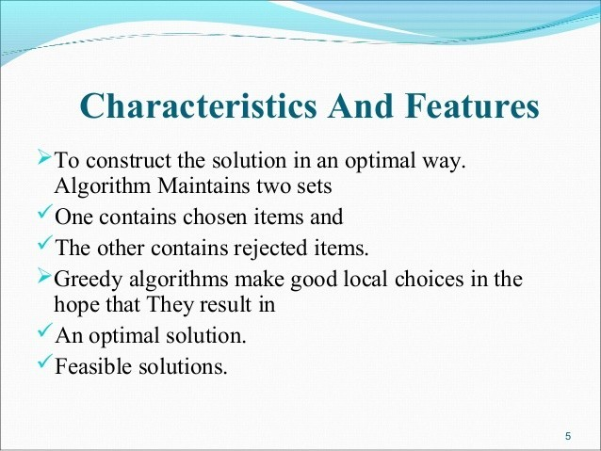
9

Slide 22
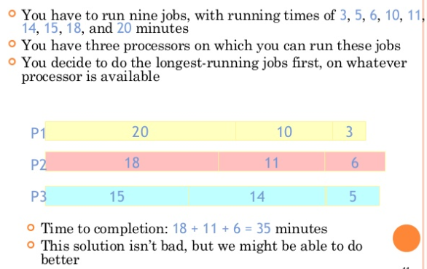
A SCHEDULING PROBLEM

Slide 23
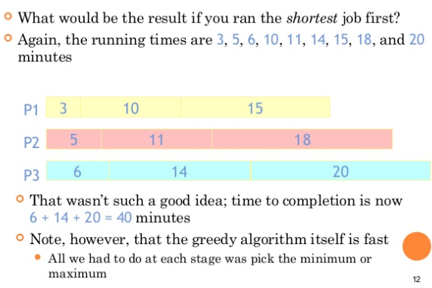
ANOTHER APPROACH
12

Slide 24
HUFFMAN ENCODING
′ The Huffman encoding algorithm is a greedy algorithm
′ You always pick the two smallest numbers to combine
′ Average bits/char:
0.22*2 + 0.12*3 +
0.24*2 + 0.06*4 +
0.27*2 + 0.09*4
= 2.42
′ The Huffman algorithm finds an optimal solution
100
54
27
A=00 B=100 C=01 D=1010 E=11 F=1011
46
15
22 12 24 6 27 9
A B C D E F

Slide 25


TRAVELING SALESMAN
′ A salesman must visit every city (starting from city A), and wants to cover the least possible distance
• He can revisit a city (and reuse a road) if necessary
′ He does this by using a greedy algorithm: He goes to the next nearest city from wherever he is
′
From A he goes to B
′ From B he goes to D
′ This is not going to result in a shortest path!
′ The best result he can get now will be ABDBCE, at a cost of 16
′ An actual least-cost path from
A is ADBCE, at a cost of 14
A B
C
2
4
3 3
4
4
D
E

Slide 26
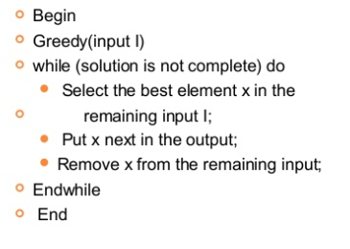
PSEOUDOCODE

Slide 27
THANK YOU

